Slide 1

EN 319
Experiment no. 3
Characteristics of DC Generators

Slide 2
Characteristics of dc generators Outline
Introduction
DC generator construction
Principle of operation
Commutator action
Equivalent circuit
Characteristics of DC generators
Armature reaction
Types of dc generators
Critical resistance concept

Slide 3
Introduction
Electric machines convert electrical energy to mechanical energy and vice-versa.
It consists of a stator, which is stationary, and a rotating part called rotor.
A small air gap is left between the two for the free rotation of the rotor.
To reduce eddy-current losses, the stator and rotor are constructed by laminations of silicon steel

Slide 4
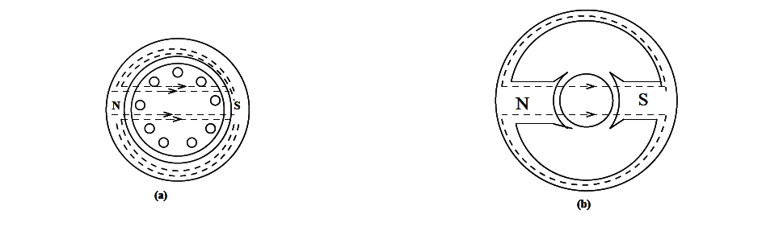
If the rotor and stator are perfectly round, the machines are called non salient pole - Fig:1(a)
They can designed to have saliency so that the magnetic reluctance is unequal along various paths - Fig:1(b)
This results in what is called, the `reluctance torque', which may be the primary or a significant means of producing torque.
FIG 1

Slide 5
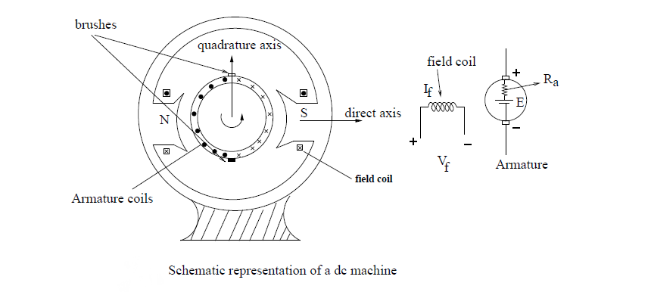
DC MACHINES CONSTRUCTION
FIG 2
The field produced by the stator current is stationary with respect to stator. This axis is called the field axis or direct (d) axis.
The rotor of dc machine has slots which contain a winding which handles electric power for conversion to (or from) mechanical power at the shaft.

Slide 6
A commutator is fixed to the rotor.
The coils of the rotor ( armature) winding are connected to these commutator segments.
A set of stationary carbon brushes (these brushes are fitted to the stator) are placed on the rotating commutator.
It should be noted that the wear due to mechanical contact between the commutator and the brushes requires regular maintenance
Detailed description on the construction:
https://www.youtube.com/watch?v=oI-O9FCDqmg

Slide 7
Principle of Operation of dc Machines
EMF is induced in the rotor due to the magnetic field at the stator.
The commutator and brushes rectify the alternating voltage induced in the armature to dc, known as mechanical rectifier.
The change over from positive to negative value takes place at a particular axis.
The angle between this axis and the d-axis is always 90 deg.
This axis is known as q-axis or the quadrature axis.
Working of dc generator is explained further in the link below
https://www.youtube.com/watch?v=iRVKAb_hs5A

Slide 8
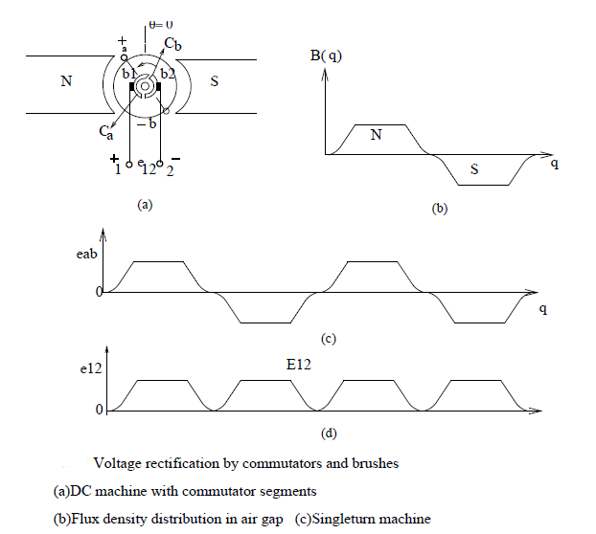

Slide 9
CHARACTERISTICS OF DC GENERATORS
1) Magnetisation Characteristics (OCC)
i) Depends on the material characteristics
ii) Same as B-H curve
iii) Same for different connections of the generator
2) Load characteristics:
i) External ( plot of terminal voltage vs. load current)
ii) Internal ( plot of generated emf vs. armature current)
All plots are defined for a fixed constant speed
of the generator

Slide 10
Magnetization curve of dc machines
Magnetic characteristic or no-load saturation characteristic also known as open circuit characteristics.
This characteristic shows the relation between generated emf at no load (E₀) and the field current (I_{f}) at a given fixed speed.
The data for O.C.C. curve is obtained by operating the generator at no load and keeping a constant speed and varying field current gradually
Detailed descriptions are given in the following links
http://www.electrical4u.com/magnetization-curve-of-dc-generator/
http://www.electricaleasy.com/2014/07/characteristics-of-dc-generators.html

Slide 11
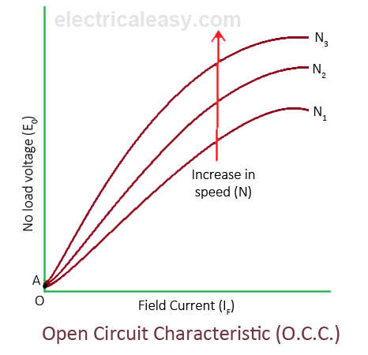
NOTE: CURVES DO NOT START FROM THE ORIGIN !!

Slide 12
Types Of Dc Generators
Self-excited dc generators
Series wound generators
Shunt wound generators
Compound wound generators
Separately Excited DC Generator
http://www.circuitstoday.com/types-of-dc-generators
http://www.studyelectrical.com/2014/08/types-of-dc-generators.html
http://circuitglobe.com/types-of-dc-generator-separately-excited-and-self-excited.html
http://www.powerelectricalblog.com/2007/03/generator-chracteristics.html

Slide 13
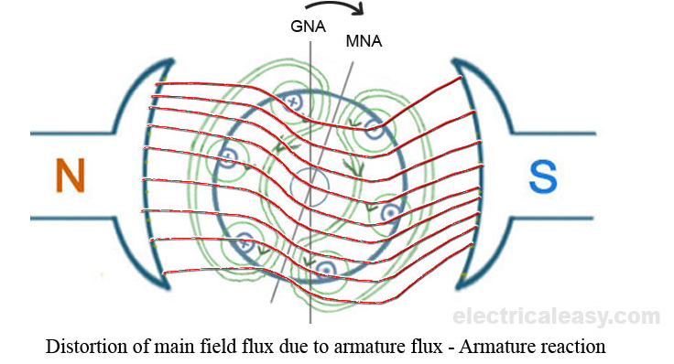
Armature reaction
In a DC machine, the main field is produced by field coils.
In both the generating and motoring modes, the armature carries current and a magnetic field is established, which is called the armature flux.
The effect of armature flux on the main field is called the armature reaction
http://www.electricaleasy.com/2013/01/armature-reaction-in-dc-machines.html

Slide 14
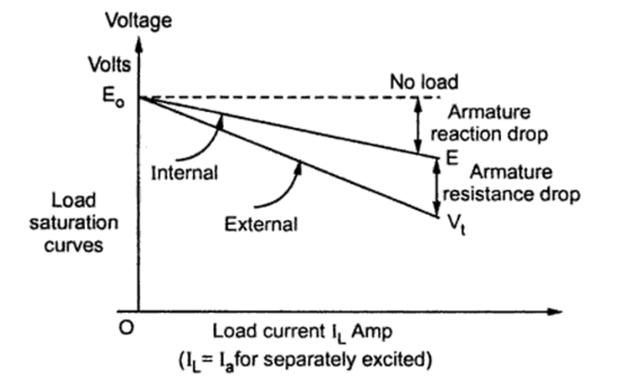
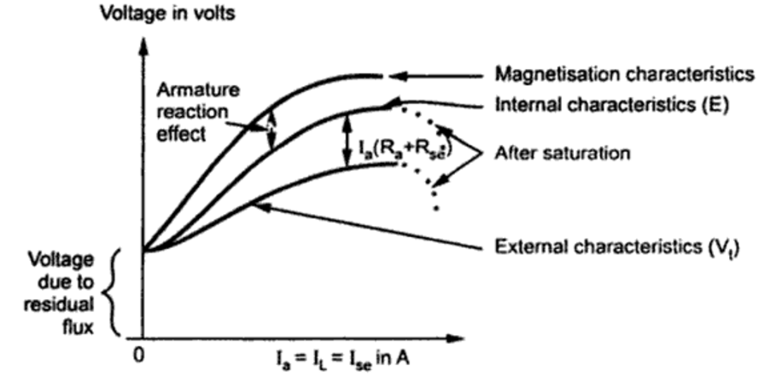
EFFECT OF ARMATURE REACTION
Separately excited generator
Series generator

Slide 15
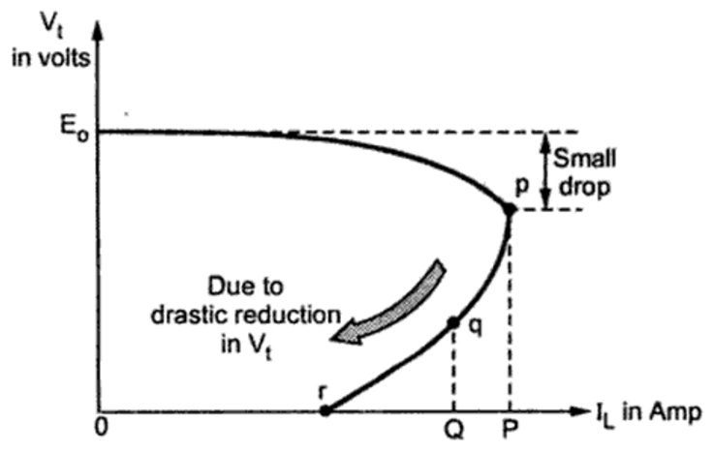
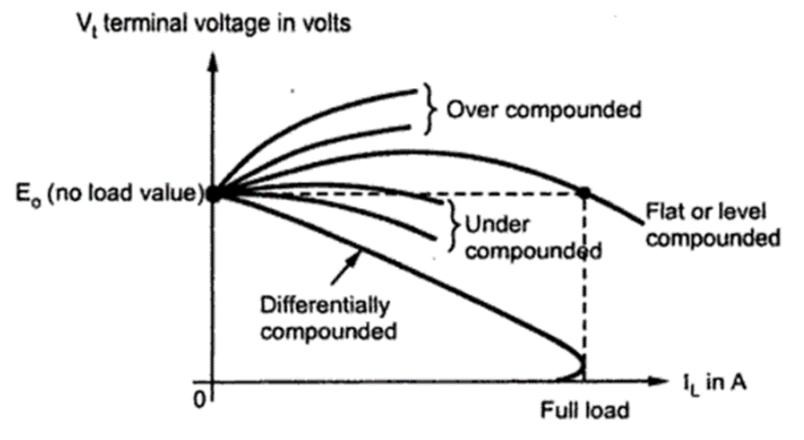
Loading beyond P causes large IR drop in armature: causing drastic reduction in terminal voltage.
Generator gets short circuited at point r ( almost zero voltage)
Shunt generator: External
characteristics
Compound generator
external characteristics

Slide 16
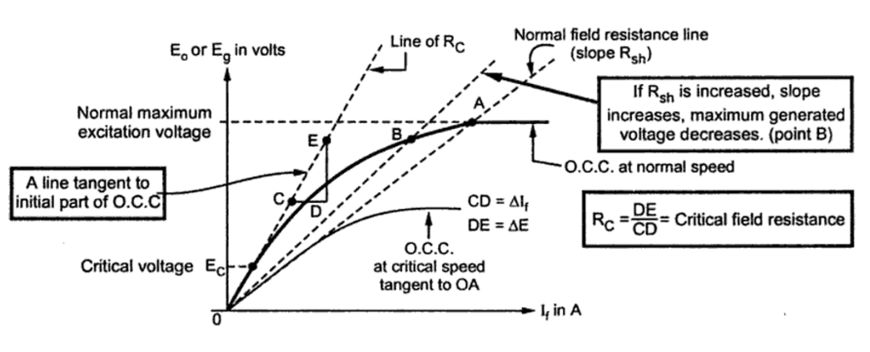
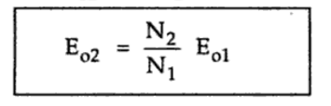
Critical resistance concept (DC SHUNT GEN.)
If field resistance is greater than Rc, the generator fails to excite.
Speed at which machine just excites for a given field resistance is critical speed Nc

